Slide 1
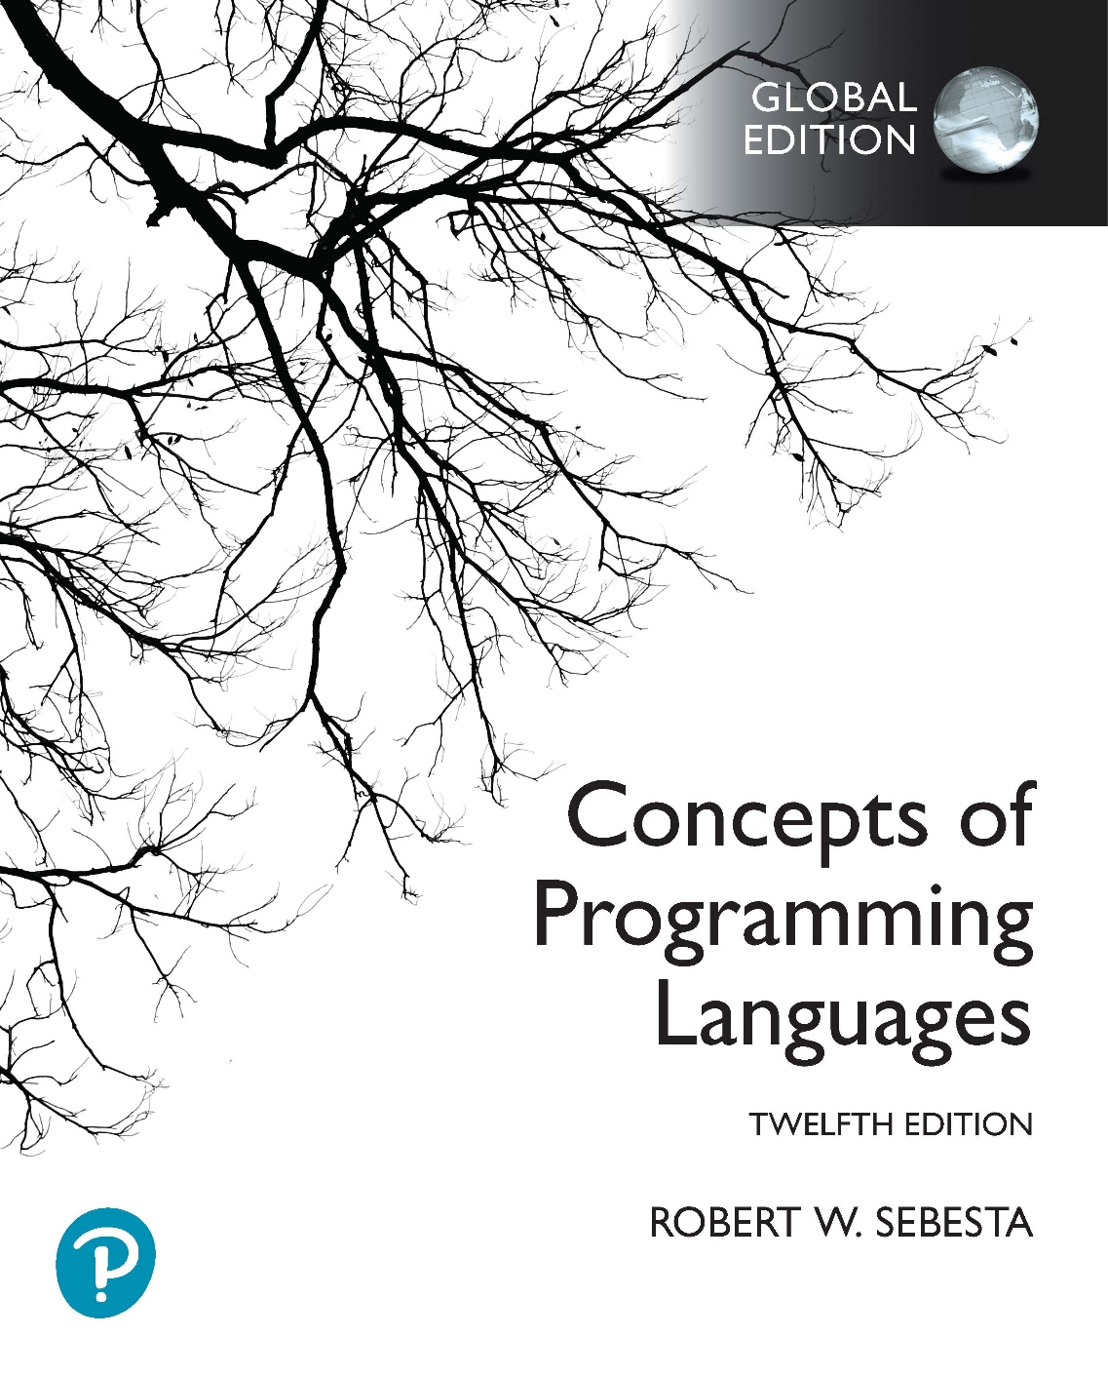
Chapter 2 Part 3
Evolution of the Major Programming Languages

Slide 2
Chapter 2 Topics
The Beginnings of Data Abstraction: SIMULA 67
Orthogonal Design: ALGOL 68
Some Early Descendants of the ALGOLs
Programming Based on Logic: Prolog
History's Largest Design Effort: Ada
Object-Oriented Programming: Smalltalk
Combining Imperative and OO Features: C++
An Imperative-Based OO Language: Java
Scripting Languages
The Flagship .NET Language: C#
Markup/Programming Hybrid Languages

Slide 3
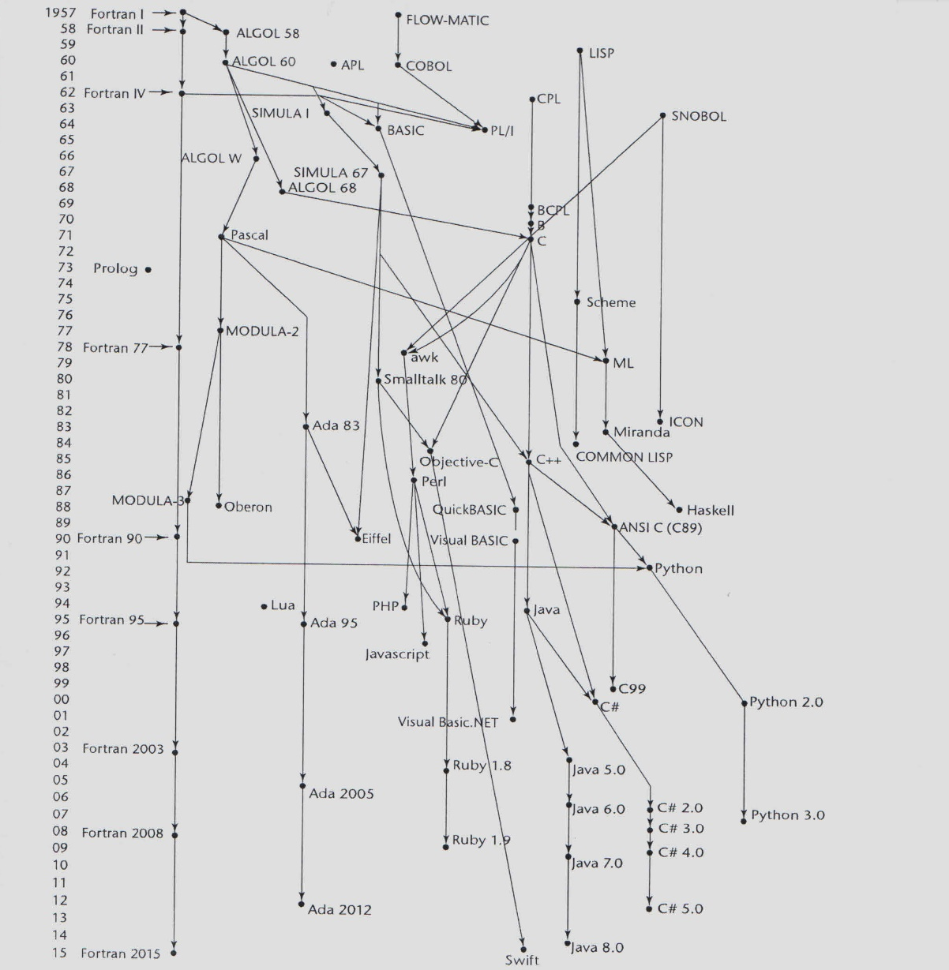
Genealogy of Common Languages

Slide 4
The Beginning of Data Abstraction: SIMULA 67
Designed in Norway by Nygaard & Dahl
Primarily for system simulation
Based on ALGOL 60 and SIMULA I
Primary Contributions
Coroutines
Subprograms that can restart at the position where they were previously stopped
The beginnings of data abstraction
Classes and objects

Slide 5
Orthogonal Design: ALGOL 68
From continued development of ALGOL 60 but very different from that language
Never achieved widespread use
But the source of several new ideas
Design is based on orthogonality
A few basic concepts
Plus a few combining mechanisms
How does this contrast to the PL/I approach to support general purpose data structures?

Slide 6
ALGOL 68 Evaluation
Contributions
User-defined data structures
Reference types
Implicit heap-dynamic arrays (flex arrays)
Comments
Less usage than ALGOL 60 and PL/I
Language description in an unknown meta-language (van Wijngaarden grammar)
Too orthogonal in some ways
Had strong influence on subsequent languages, especially Pascal, C, and Ada

Slide 7
Pascal
Developed in 1971 by Wirth (a former member of the ALGOL 68 committee)
Small and simple
Nothing really new
For teaching structured programming
From mid-1970s until the late 1990s, the most widely used language for teaching programming
Still used in South African schools in the early 2000s

Slide 8
C
Developed in 1972 by Dennis Richie
For systems programming at Bell Labs
Evolved primarily from CPL, BCPL and B, but also from ALGOL 68
Powerful set of operators and functions
Poor type checking and other unsafe features
Initially spread through UNIX
Many areas of application
ANSI standard only in 1989, updated in 1999

Slide 9
Programming Based on Logic: Prolog
Programmation en logique
Collaborative developed
Comerauer & Roussel (University of Aix-Marseille)
Help from Kowalski (University of Edinburgh)
Overview
Based on formal logic
Non-procedural
Database of facts, combined with rules
Uses an inferencing process to infer the truth of queries
Highly inefficient
Few application areas

Slide 10
History’s Largest Design Effort: Ada
Developed for the US DoD
More than 450 languages were in use for DoD projects
They needed a standardized programming language
Initially intended for embedded system development
Huge design effort, involving hundreds of people, much money, and about 8 years
Strawman requirements (April 1975)
Woodman requirements (August 1975)
Tinman requirements (1976)
Ironman requirements (1977)
Steelman requirements (1978)
Stoneman document (1980)
ANSI standard (1983)
Named after Ada Byron the first programmer

Slide 11
Ada Evaluation
Contributions
Packages: Support for data abstraction
Exception handling: A very elaborate system
Generic program units
Concurrency: Through the tasking and rendezvous model
Comments
Competitive design
Included all that was then known about software engineering and language design
Usable compilers were not immediately available
Development of first compilers was very difficult
First usable compiler nearly five years after language design

Slide 12
Recent Versions of Ada
Ada 95
Support for OOP
Type derivation
Subprogram dispatching
New concurrency features (e.g. protected objects)
More flexible libraries
Popularity suffered
DoD no longer required its use
Also because of the popularity of C++
Ada 2005
Interfaces (like in Java)
Ada 2012
Contract-based programming support
Multicore programming support

Slide 13
Object-Oriented Programming: Smalltalk
Developed at Xerox PARC
Initially by Alan Kay
Later by Adele Goldberg
First full implementation of true OO
Data abstraction
Inheritance
Dynamic binding
Pioneered and promoted
Graphical user interface design
The OOP paradigm

Slide 14
Combining Imperative and Object-Oriented Programming: C++
Developed at Bell Labs by Stroustrup in 1980
Evolved from C and SIMULA 67
A large and complex language
Procedural (from C) and OOP (partially from SIMULA 67)
Exception handling, operator overloading, pointers, references, template functions and classes
Rapidly grew in popularity
Good, cheap compilers
Backward-compatible with C
Only OO language at the time suitable for large projects
ANSI standard approved in November 1997
Microsoft’s Managed C++ (with .NET in 2002):
Properties, delegates, interfaces, no multiple inheritance

Slide 15
Related OOP Languages
Swift
Replacement for Objective-C released in 2014
Two type categories: classes and structs (similar to C#)
Used by Apple for systems programs
Delphi
Developed by Anders Hejlsberg (also designed Turbo Pascal, C#)
Pascal with features to support OOP
More elegant and safer than C++
Go
Designed at Google in 2009
Loosely based on C, but also quite different
Allows an object-oriented style of programming
But does not support traditional OOP

Slide 16
An Imperative-Based Object-Oriented Language: Java
Developed at Sun in the early 1990s
Initially for embedded electronic devices
C & C++ not well suited to this task (unreliable)
Based on C++
Significantly simplified and more reliable
Discards C++ features
Removes struct, union, and enum
No pointers & pointer arithmetic (references only)
Half the assignment coercions
Supports only OOP
Support for applets, concurrency, & GUI design
Notes:
Java does support enumerations, but they are implemented as classes, not primitive ordinal types, as in C++.

Slide 17
Java Evaluation
Eliminated many unsafe features of C++
Less powerful and flexible than C++
Many built-in libraries
Concurrency, applets, GUIs, database access
Portable
Java Virtual Machine, JIT compilers
Widely used for Web programming
Use increased incredibly quickly
Java 21, released in 2023

Slide 18
Scripting Languages for the Web
In general, scripting languages are imperative
Differences from normal imperative languages
Intended purpose
Scripting languages: Smaller tasks
Full imperative languages: Larger tasks
Implementation system
Scripting languages: Usually interpreted
Full imperative languages: Usually compiled
Constructs
Scripting languages: Usually mostly dynamic
Full imperative languages: More static features

Slide 19
Scripting Languages for the Web
Perl
Designed by Larry Wall in 1987
Variables statically typed but implicitly declared
Three namespaces, denoted by 1st character of a variable’s name (scalars - $, arrays - @, hashes - %)
Powerful, but somewhat dangerous
Dynamic length, sparse arrays
Coercisions between strings and numbers
No error detection for array access
Language uses
Initially for UNIX system text file processing
Widespread use for CGI programming on the Web
Still used for UNIX general system administration

Slide 20
Scripting Languages for the Web
PHP
Designed by Rasmus Lerdorf
Name
Originally Personal Home Page
Later the recursive name PHP: Hypertext Preprocessor
Server-side, HTML-embedded scripting language
Often used for form processing
Also database access via the Web
Purely interpreted

Slide 21
Scripting Languages for the Web
JavaScript
Began at Netscape
Then joint venture of Netscape & Sun Microsystems
A client-side, HTML-embedded
Often for dynamic HTML documents
Purely interpreted
Related to Java only through similar syntax

Slide 22
Scripting Languages for the Web
Python
An OO interpreted scripting language
Similar applications as Perl
CGI programming and form processing
System administration
More recent use in data science
Type checked, but dynamically typed
Pattern matching facilities, exception handling, and garbage collection
Supports lists, tuples, and hashes
A large number of external libraries

Slide 23
Scripting Languages for the Web
Ruby
Designed by Yukihiro Matsumoto (a.k.a. “Matz”)
First Japanese language to be widely used in US
Began as a replacement for Perl and Python
Purely interpreted
A very pure object-orientation design
All data are objects
Most operators are implemented as methods
User code can redefine operators
Classes and objects are dynamic
They can have different methods at different times

Slide 24
The Flagship .NET Language: C#
Part of the .NET development platform
Announced in 2000, released in 2002
Based on C++, Java, and Delphi
Improved many C++ features
Added some novel features for the time
Pointers, delegates, properties, enumeration types, limited dynamic typing, and anonymous types
Supports component-based development
Common Type System for .NET languages
Provides common class library and interoperability
Intermediate Language (IL) and JIT compiler
Evolving very rapidly

Slide 25
Markup and Programming Hybrid Languages
XSLT
eXtensible Markup Language (XML)
A metamarkup language
eXtensible Stylesheet Language Transformation document
Describes how to convert XML documents for display
Programming constructs (e.g. looping and sorting)
XSLT processor
Takes XML document and XSLT document as input
Produces output in XML, HTML, or text

Slide 26
Markup and Programming Hybrid Languages
JSP
Java Server Pages
A collection of technologies to support dynamic Web documents
JSP Standard Tag Library (JSTL) markup has programming constructs in the form of HTML elements
JSP document requested by browser, and converted to a servlet
Servlet
A Java class that resides on a Web server
Executed by a servlet container
A servlet’s HTML output is displayed by the browser

